Slide 1



Peak ETL
Open-source Technology Success
Jason Holden
www.peaketl.com
CEO, PRESENTOR
JASON@PEAKETL.COM | (918) 409-CODE (2633) | (719) 200-9872

Slide 2

About Me Professional developer for more than 25 years
Our Story (so far):
I started working with computers at the age of 13. Growing up in a small town in eastern Oklahoma, I acquired a reputation as the “computer kid.” I started my professional career programming applications using Visual FoxPro. Over the last twenty-five years, I’ve used numerous other languages and platforms to develop countless database applications and services. My newest endeavor is Peak ETL. We’re creating a subscription-based platform to aggregate and analyze public oil and gas data and deliver it to industry professionals for use in their operations.
Jason Holden
CEO & Founder

Slide 3

Open-source
Development.
Why Open Source?
Cost
Cost: Tools like Docker, Flask, and PostgreSQL reduce licensing costs compared to commercial solutions like Microsoft SQL Server or Azure
Flexibility: Provides unparalleled flexibility, allowing developers to modify source code, integrate diverse technologies, and deploy applications across various platforms without vendor lock-in
Community: Active and talented communities contribute to rapid development, troubleshooting, and feature enhancements
Transparency: Community members can review and audit the source for security vulnerabilities
Everywhere: Open source is everywhere, from tech giants (including Microsoft) to little startups (like Peak ETL)
Reduce licensing costs compared to commercial solutions.
Advancement
Open-source projects advance faster.
Customizable
Modify for specific business needs.
Notes:
The correct usage is "open source" (without a hyphen) when referring to the concept in general and "open-source" (with a hyphen) when used as an adjective before a noun, like "open-source software."

Slide 4










Our
Stack.
The Best of Both Worlds
Code: C#, Java, Python, and JavaScript
Database: Postgres, Microsoft SQL, and MongoDB
Source control: Github.com
OS: Linux and Windows

Slide 5
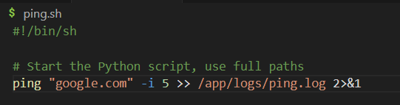
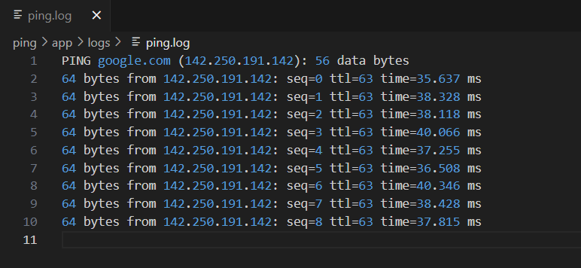
Demo
PING
PING a remote server
Code: ping.sh to execute PING and log to a file
Container: Dockerfile maps /app folder on the host for easy access to log files

Slide 6
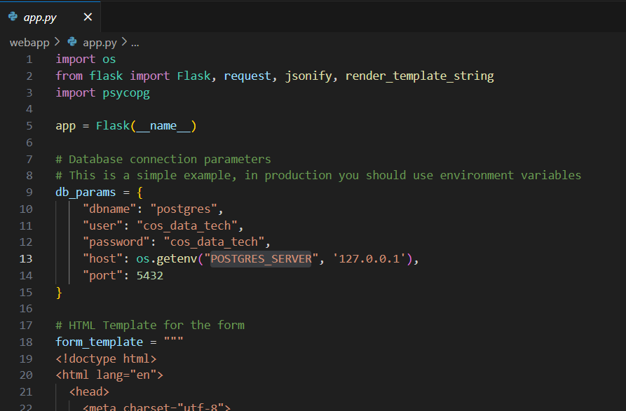
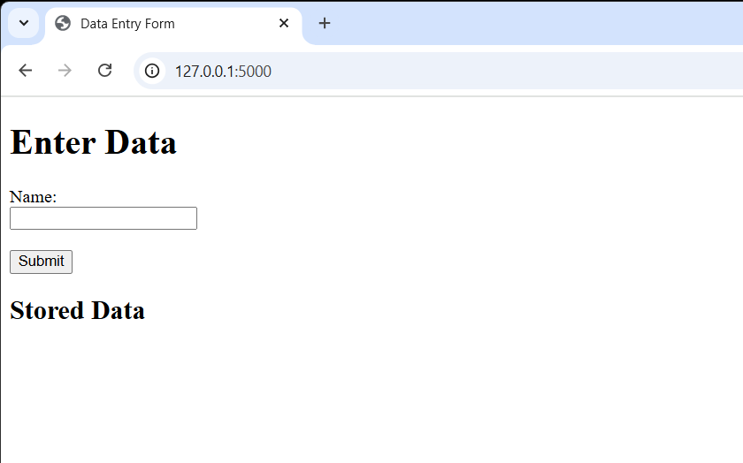
Demo
Web Application
Flask Web Application
Code: app.py Flask application with single data entry form
Containers: App_Dockerfile (Python) and DB_Dockerfile (Postgres)

Slide 7
Key
Take Aways
Open Source is the Future
Development: Open source can jump-start your development
Not mutually exclusive: You can have the best of both worlds
Future proof: Leading AI toolsets are built on open-source technology

Slide 8

Contact
Us.
GitHub
https://github.com/peaketl/cos-data-and-technology-03-19-2025
CONTACT
(719) 200-9872 (918) 409-2633
www.peaketl.com
jason@peaketl.com

